Slide 1
Recyklovanie
Z pohľadu financií

Slide 2
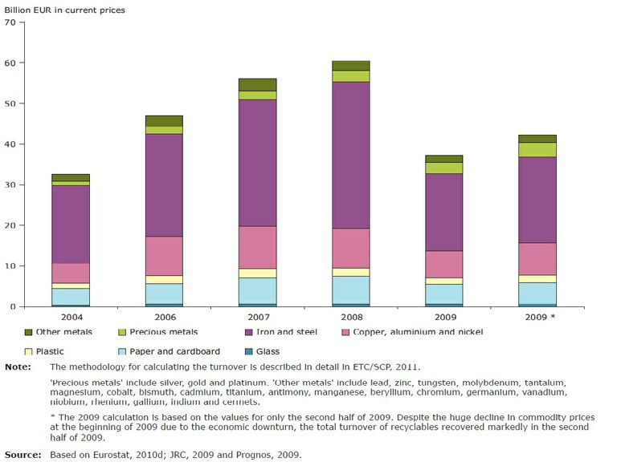
Recyklovanie v EÚ
Total turnover of recycling of seven key recyclables in the EU, 2004 and 2006–2009

Slide 3
Recyklovanie v EÚ
Recycling nowadays appears to be functioning on industrial basis which reduces the waste disposal and thereof natural resource consumption and energy efficiency improvement. As a result, it sustains an economic and business interest for entrepreneurs all over the world. The EU held a 50% world tonnage share of the waste and recycling industries. EU eco-industries sector gained a turnover of around 227 billion ? corresponding to 2.2% of EU GDP in 2007. This includes waste treatment (?2 billion) and recycling (?4 billion, over 500,000 jobs). The recycling sector is made up of over 60,000 companies; the profile of which is categorized into the following percentages i.e. 3% large; 28% medium; 69% small [29].

Slide 4
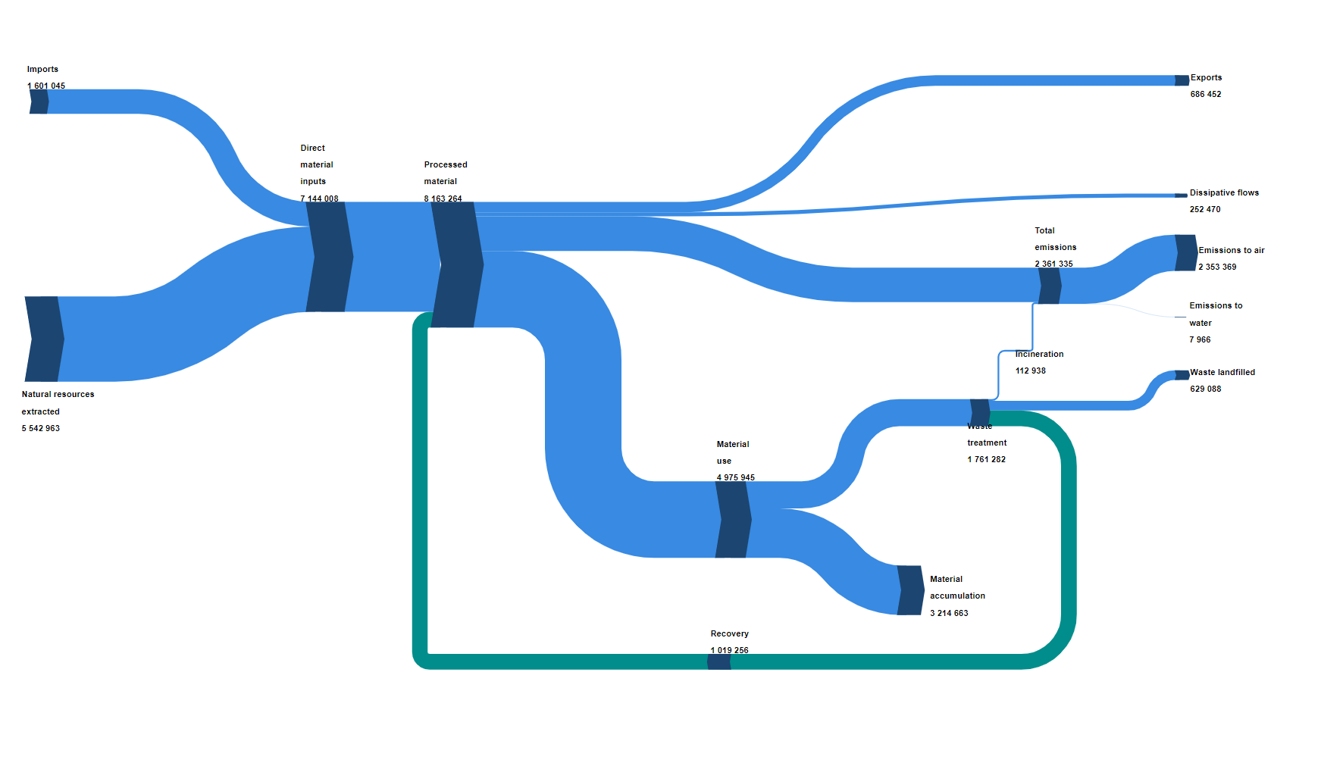
Recyklovanie v EÚ
https://ec.europa.eu/eurostat/cache/sankey/circular_economy/sankey.html?geos=EU27&year=2022&unit=THS_T&materials=TOTAL&highlight=&nodeDisagg=0101000000&flowDisagg=false&language=EN&material=TOTAL

Slide 5
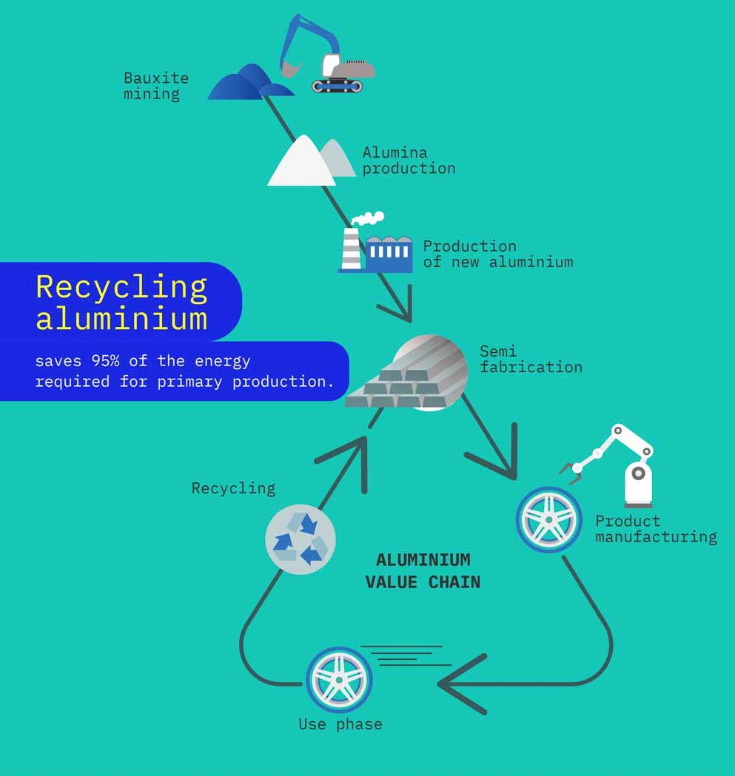
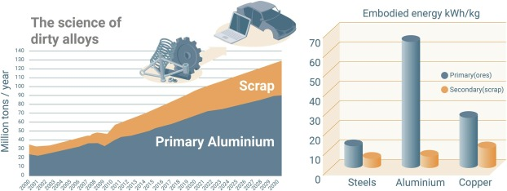
Recyklovanie hliníka

Slide 6
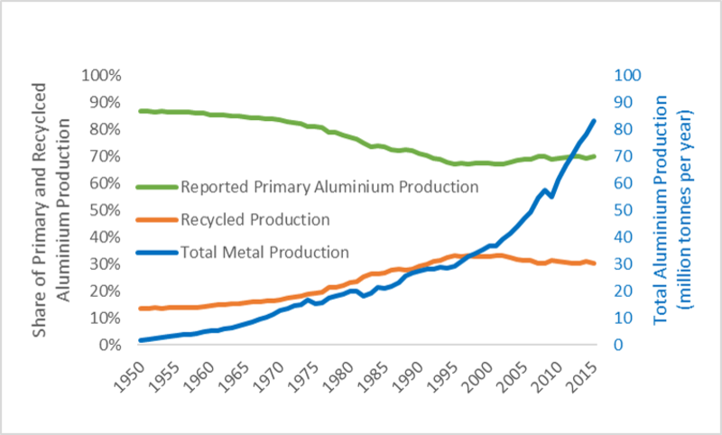
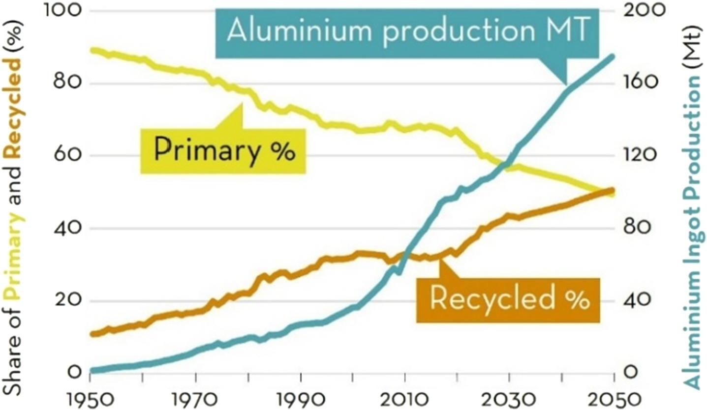
Recyklovanie hliníka

Slide 7

Recyklácia plastov

Slide 8
Recyklovanie plastov
Issues: Quality of plastic waste
EÚ:
In November 2022, the Commission proposed new EU-wide rules on packaging, including proposals to improve packaging design, such as clear labelling, to promote reuse and recycling and calls for a transition to bio-based, biodegradable and compostable plastics.
As part of the Green Deal, 55% of plastic packaging waste should be recycled by 2030. This would imply better design for recyclability, but MEPs believe measures to stimulate the market for recycled plastic are also needed.

Slide 9
What is the circular economy?
The circular economy is a model of production and consumption, which involves sharing, leasing, reusing, repairing, refurbishing and recycling existing materials and products as long as possible. In this way, the life cycle of products is extended.
In practice, it implies reducing waste to a minimum. When a product reaches the end of its life, its materials are kept within the economy wherever possible thanks to recycling. These can be productively used again and again, thereby creating further value.

Slide 10
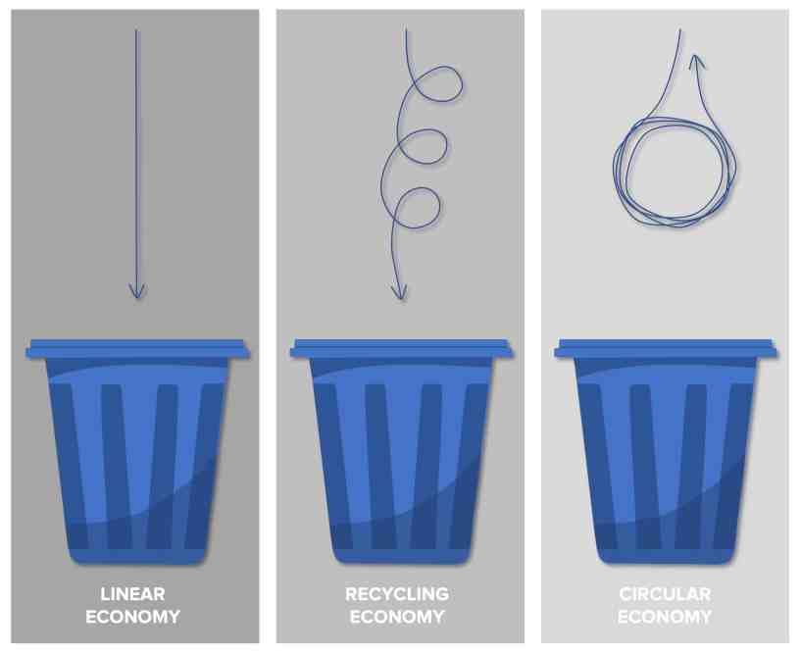
What is the circular economy?

Slide 11
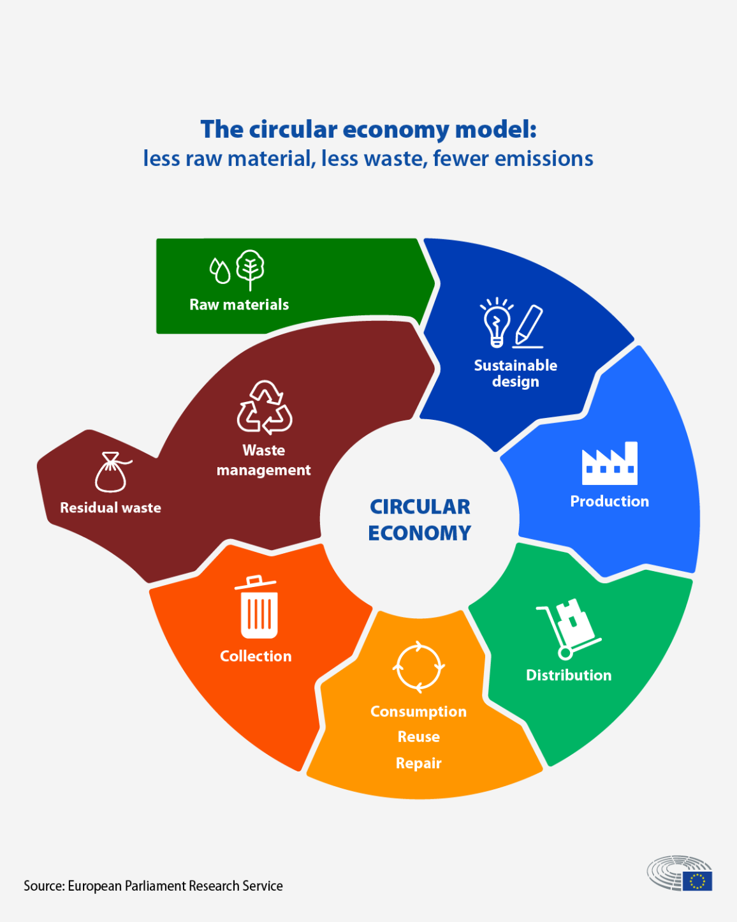
What is the circular economy?

Slide 12
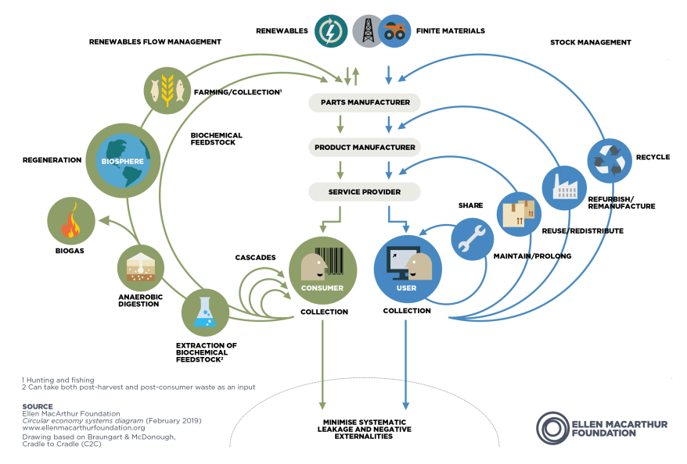
Refuse
Rethink
Reduce
Reuse
Repair
Refurbish
Remanufacture
Repurpose
Recycle
Recover

Slide 13
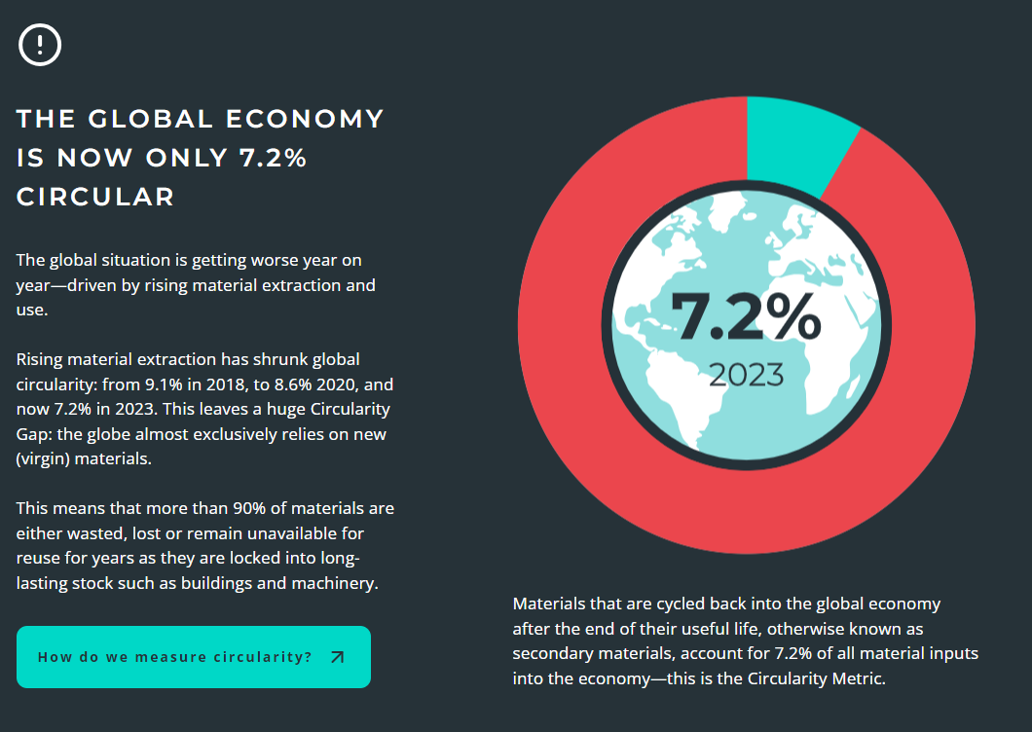
Source: www.circularity-gap.world/2023

Slide 14
EÚ
Radio Equipment Directive: common charger for electronic devices
USB-C will be mandatory for phones sold in the EU ‘by autumn 2024’
With Apple’s iPhone 15, the EU wins the charger war

Slide 15
EÚ
Radio Equipment Directive: common charger for electronic devices
EU Battery Regulation Proposal released to Replace the Battery Directive (2006/66/EC)
The regulation provides that by 2027 portable batteries incorporated into appliances should be removable and replaceable by the end-user

